Slide 1
Python and clustering
https://scikit-learn.org/stable/modules/tree.html#classificationhttps://machine-learning-python.kspax.io/
https://realpython.com/k-means-clustering-python/#understanding-the-k-means-algorithm

Slide 2
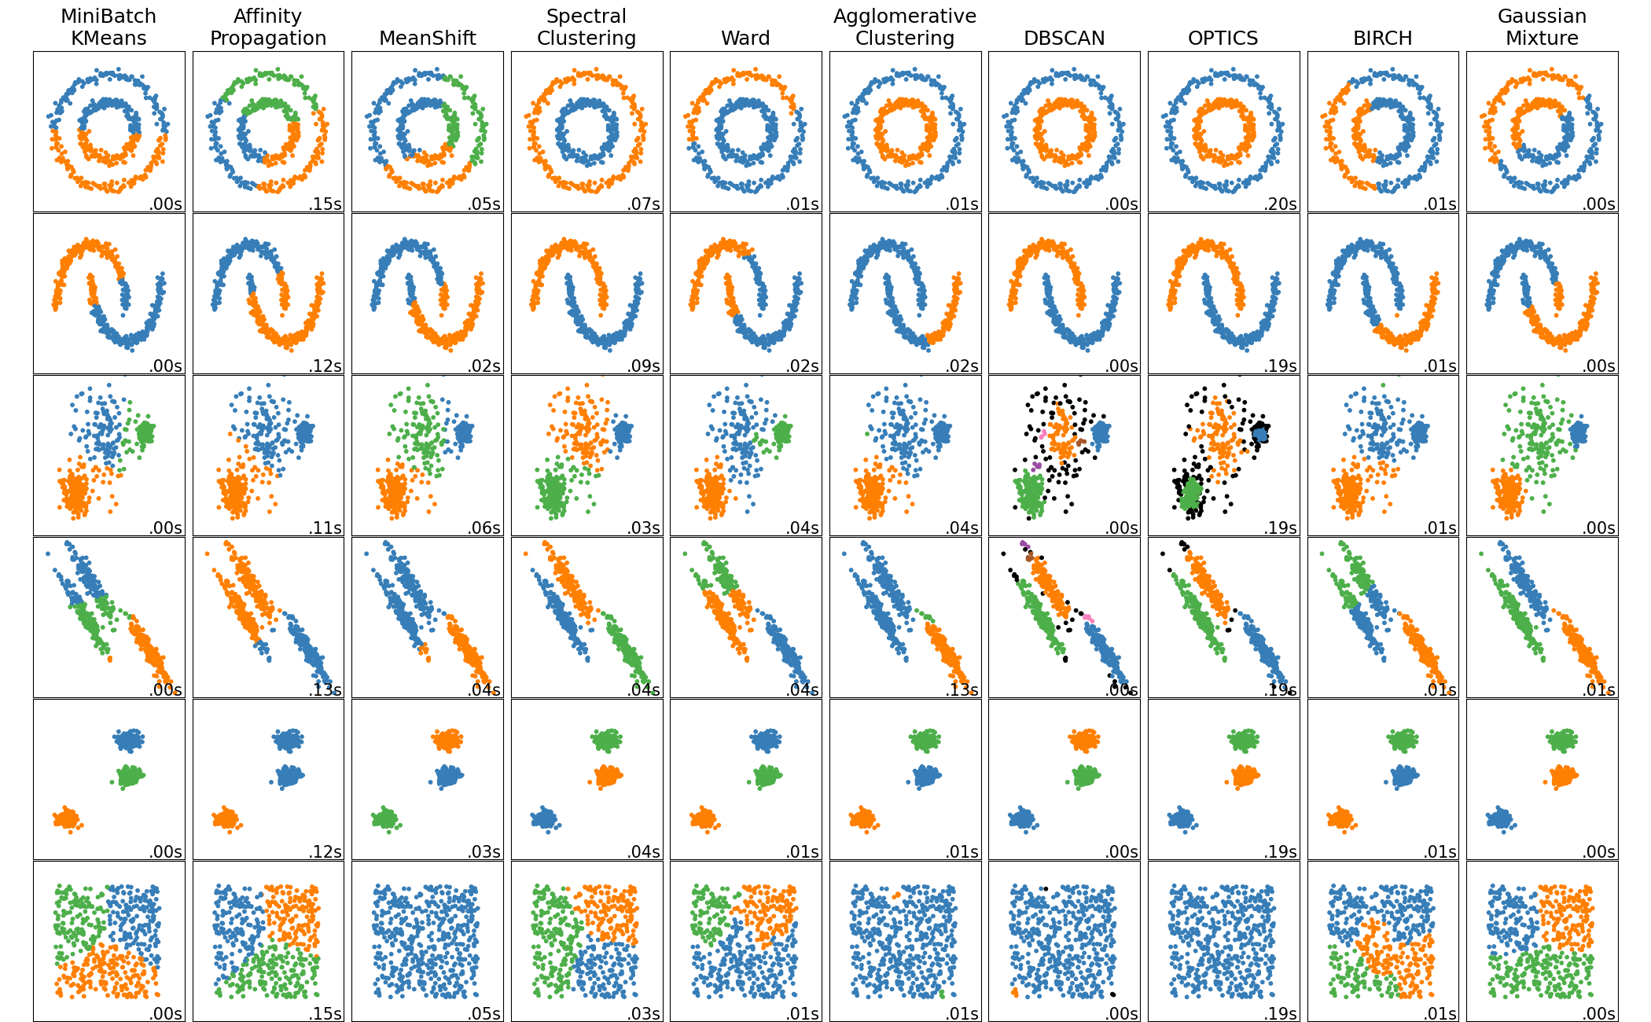
Clustering

Slide 3
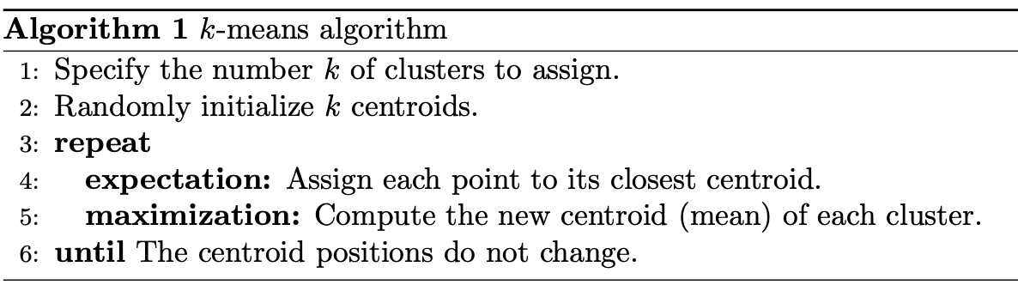
K-means (資料來源: Real Python )
https://realpython.com/k-means-clustering-python/#understanding-the-k-means-algorithm

Slide 4
K-means
隨機選k個重心點 m1, m2,…,mk
重複做以下步驟:
Assignment: 對於每個case，從m1, m2,…,mk中選一個到這一case最短的的重心，將這個case分配到它所代表的cluster)，因此形成k個cluster
重新計算重心點m1, m2,…,mk

Slide 5
K-means
Image source: Wiki-pedia
https://en.wikipedia.org/wiki/K-means_clustering
From real Python https://realpython.com/k-means-clustering-python/#understanding-the-k-means-algorithm

Slide 6
在Python上進行clustering 分析
範例 from Real Python jablonskidev
參考
https://realpython.com/k-means-clustering-python/#understanding-the-k-means-algorithm

Slide 7
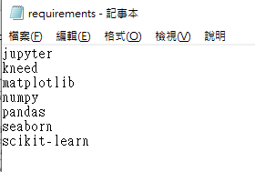
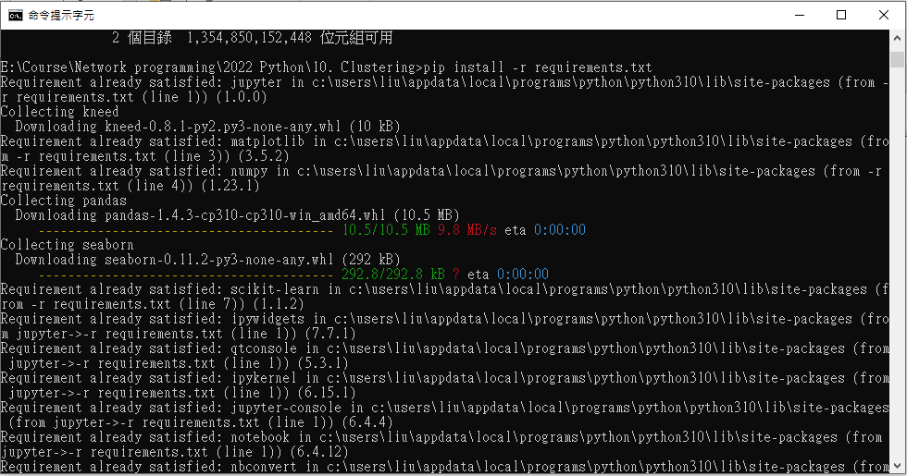
安裝套件
https://github.com/realpython/materials/tree/master/practical-k-means
“pip install -r requirements.txt”
Inside requirements.txt are
Jupyter
Kneed
Matplotlib
Numpy
Pandas
Seaborn
scikit-learn

Slide 8
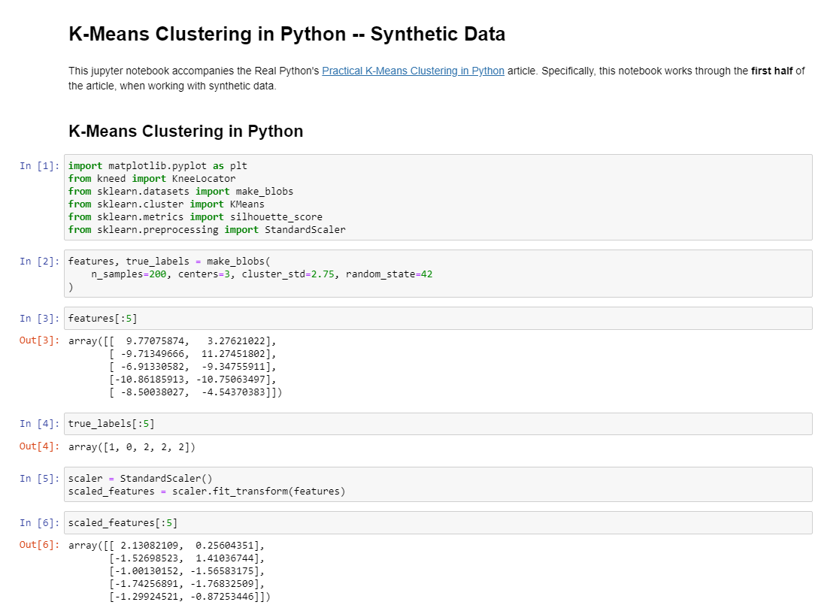
打開範例notebook
Download jupyter notebook practical-k-means-syntethic from https://github.com/realpython/materials/tree/master/practical-k-means
By commend at the console “jupyter notebook practical-k-means-syntethic.ipynb”

Slide 9
載入套件
import matplotlib.pyplot as plt
from kneed import KneeLocator
from sklearn.datasets import make_blobs
from sklearn.cluster import KMeans
from sklearn.metrics import silhouette_score
from sklearn.preprocessing import StandardScaler

Slide 10
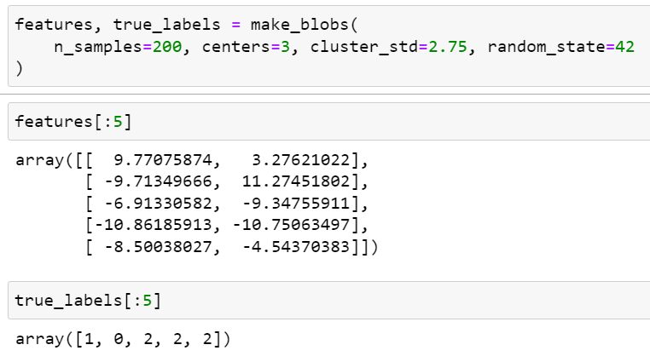
產生資料
make_blobs() returns a tuple of two values:
A two-dimensional NumPy array with the x- and y-values for each of the samples
A one-dimensional NumPy array containing the cluster labels for each sample
features, true_labels = make_blobs(
n_samples=200,
centers=3,
cluster_std=2.75,
random_state=42
)
#產生clustering測試資料
features[:5]
true_labels[:5]
#檢視資料內容與對應的label
make_blobs : Generate isotropic Gaussian blobs for clustering. 產生資料
n_features: The number of features for each sample. (default=2)
n_samples: the total number of points
Centers: The number of centers to generate
cluster_std: The standard deviation of the clusters.

Slide 11

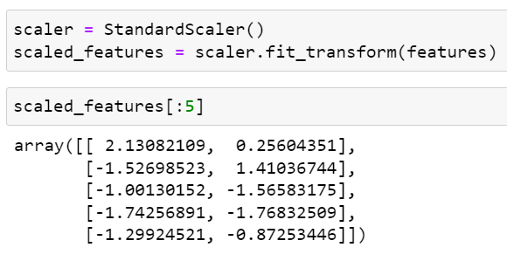
前處理: 標準化
兩個feature可能尺度(Mean與標準差)差距很大，為了避免造成較大Mean值得feature過度影響分群，因此需進行標準化
The process of transforming numerical features to use the same scale is known as feature scaling.
scaler = StandardScaler()
scaled_features = scaler.fit_transform(features)
#將資料進行標準化
scaled_features[:5]
#檢視標準化後的資料內容
StandardScaler: Standardize features by removing the mean and scaling to unit variance (mean =0 and standard deviation = 1)
The standard score of a sample x is calculated as: z = (x - u) / s, where u is the mean of the training samples or zero

Slide 12
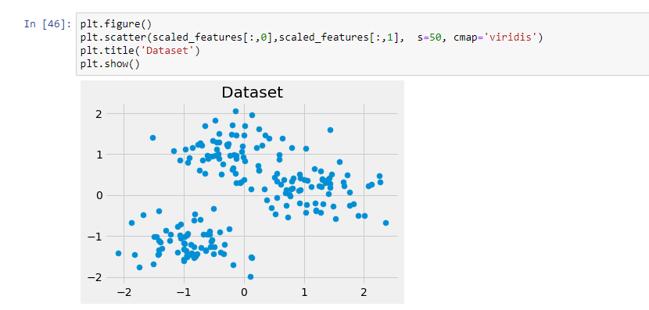
前處理: 標準化
plt.figure()
plt.scatter(scaled_features[:,0], scaled_features[:,1], s=400, cmap='voridis')
plt.title('Dataset')
plt.show()
X陣列
Y陣列
以plt.scatter畫出資料散佈圖
plt.scatter(x陣列, y陣列…)

Slide 13
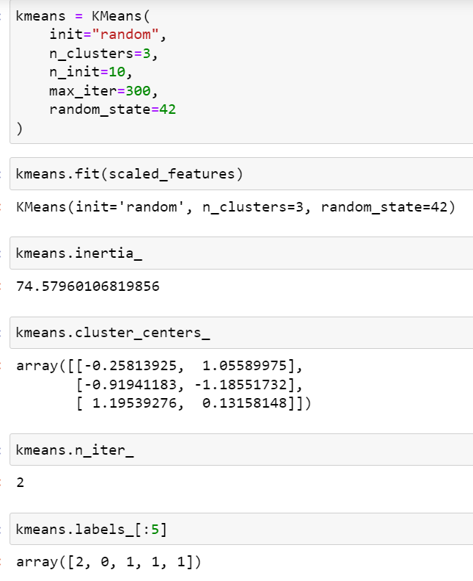
K-means estimator
kmeans = KMeans(
init="random", n_clusters=3,
n_init=10, max_iter=300,
random_state=42
)
Randomly select initial cluster centroids, to form 3 clusters, by performing 10 times of the k-means algorithm with different centroid seeds with 300 of iterations of the k-means algorithm for a single run.
init controls the initialization technique.
n_clusters sets k for the clustering step.
n_init sets the number of initializations to perform. (要做幾次K-means 計算，再從中挑最好的一次回傳回來)
max_iter sets the number of maximum iterations for each initialization of the k-means algorithm. (K-means的演算法要重新計算重心最多幾次)

Slide 14
K-means estimator
kmeans.fit(scaled_features)
#套入剛剛產生的資料
kmeans.inertia_ #最低的SSE(平方誤差和)
kmeans.cluster_centers_ #重心座標
kmeans.n_iter_ #收斂所需的迭代次數
kmeans.labels_[:5] #分群的label

Slide 15
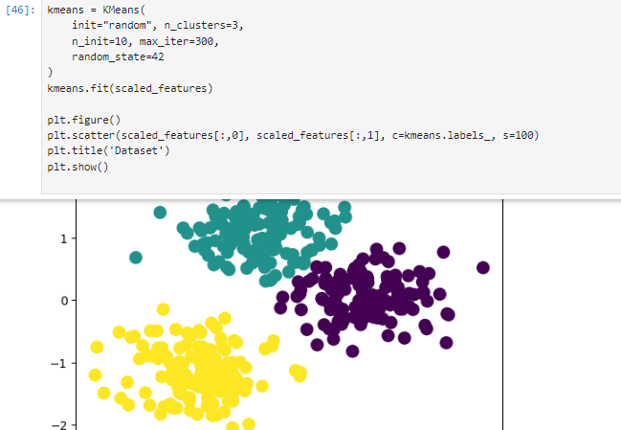
劃出分群的圖
X陣列
Y陣列
分群結果陣列
plt.figure()plt.scatter(scaled_features[:,0], scaled_features[:,1], c=kmeans.labels_, s=400)
plt.title('Dataset')
plt.show()

Slide 16
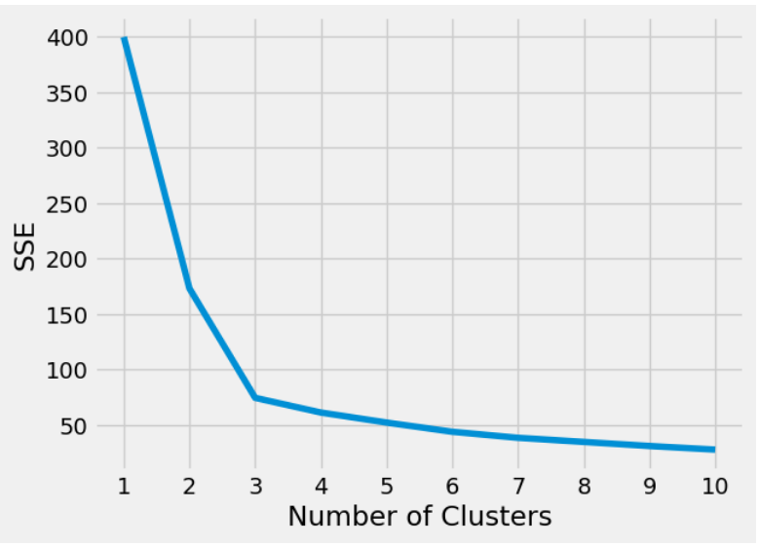
How to Choose the Number of Clusters( elbow method)
plt.style.use("fivethirtyeight")
plt.plot(range(1, 11), sse)
plt.xticks(range(1, 11))
plt.xlabel("Number of Clusters")
plt.ylabel("SSE")
plt.show() #將結果繪圖顯示
kmeans_kwargs = {
"init": "random",
"n_init": 10,
"max_iter": 300,
"random_state": 42,
}
# 以動態k=1-10分群，求最小SSE值的k值
# A list holds the SSE values for each k
sse = []
for k in range(1, 11):
kmeans = KMeans(n_clusters=k, **kmeans_kwargs)
kmeans.fit(scaled_features)
sse.append(kmeans.inertia_)
#產生重心數量為1~10時的SSE list
肘點(elbow point)符合低群集數低SSE的原則

Slide 17
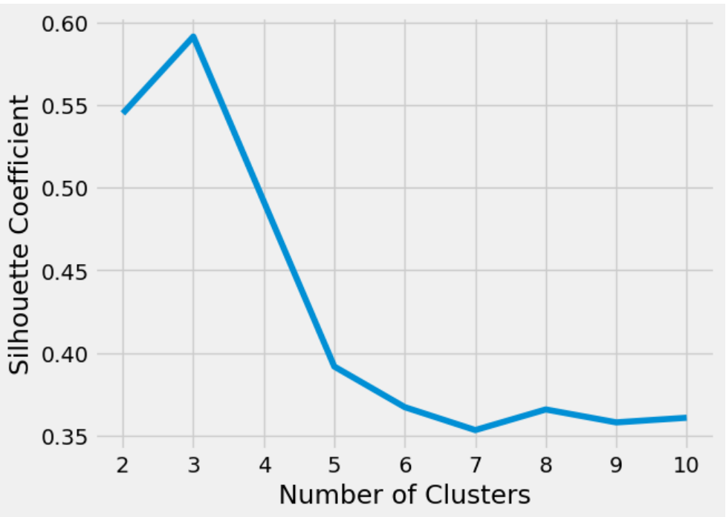
How to Choose the Number of Clusters
plt.style.use("fivethirtyeight")
plt.plot(range(2, 11), silhouette_coefficients)
plt.xticks(range(2, 11))
plt.xlabel("Number of Clusters")
plt.ylabel("Silhouette Coefficient")
plt.show() #將結果繪圖顯示
silhouette_coefficients = []
for k in range(2, 11):
kmeans = KMeans(n_clusters=k,
**kmeans_kwargs)
kmeans.fit(scaled_features)
score = silhouette_score(
scaled_features, kmeans.labels_)
silhouette_coefficients.append(score)
#產生重心數量為2~10時的輪廓係數(silhouette coefficient) list

Slide 18
癌症基因案例(自行參考)

Slide 19
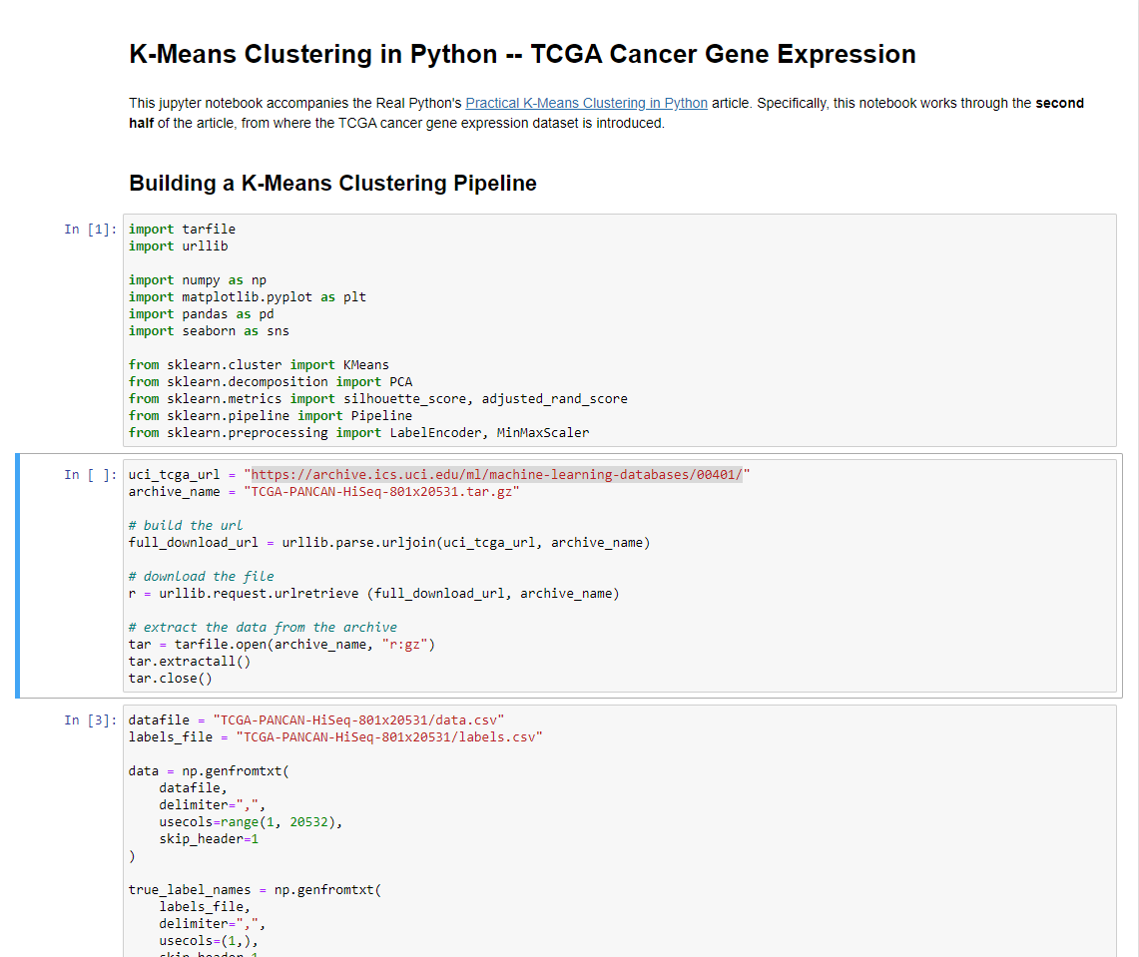
打開範例notebook
By commend at the console “jupyter notebook practical-k-means-cancer-gene-expression.ipynb ”
先檢視 https://archive.ics.uci.edu/ml/machine-learning-databases/00401/ 的TCGA-PANCAN-HiSeq-801x20531.tar.gz (7-zip解壓縮)
CSV格式(“,” 與換行作為資料分隔)

Slide 20
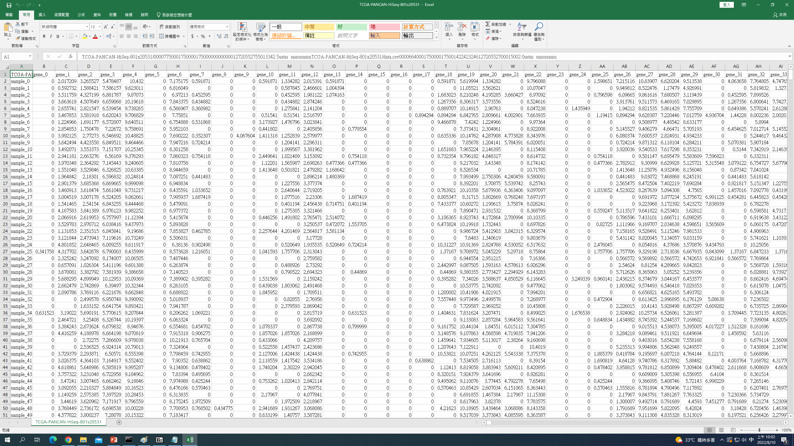
檢視資料檔案
以EXCEL打開CSV格式檔案(以“,” 作為資料分隔)
第一欄為sample 編號，接著gene_0 ~ gene_20530共20532欄

Slide 21
載入套件
import tarfile
import urllib
import numpy as np
import matplotlib.pyplot as plt
import pandas as pd
import seaborn as sns
from sklearn.cluster import KMeans
from sklearn.decomposition import PCA
from sklearn.metrics import silhouette_score, adjusted_rand_score
from sklearn.pipeline import Pipeline
from sklearn.preprocessing import LabelEncoder, MinMaxScaler

Slide 22
下載並解壓縮資料檔
uci_tcga_url = "https://archive.ics.uci.edu/ml/machine-learning-databases/00401/"
archive_name = "TCGA-PANCAN-HiSeq-801x20531.tar.gz"
# build the url
full_download_url = urllib.parse.urljoin(uci_tcga_url, archive_name) # 串接網址
# download the file
r = urllib.request.urlretrieve (full_download_url, archive_name)# download 資料檔
# extract the data from the archive
tar = tarfile.open(archive_name, “r:gz”) # 打開壓縮檔
tar.extractall() # 解壓縮
tar.close()

Slide 23
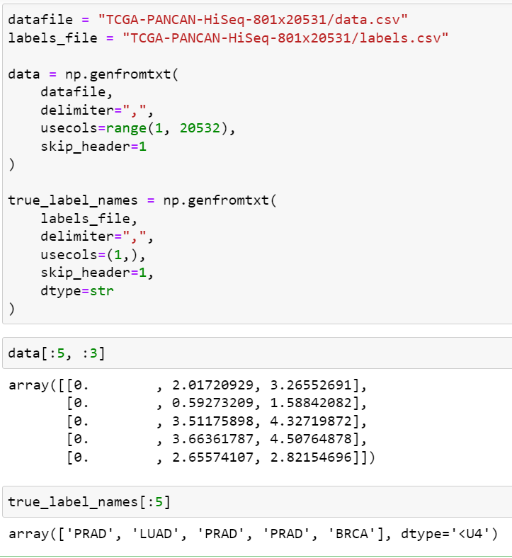
載入資料檔案
datafile = "TCGA-PANCAN-HiSeq-801x20531/data.csv"
labels_file = "TCGA-PANCAN-HiSeq-801x20531/labels.csv"
data = np.genfromtxt(
datafile, delimiter=",",
usecols=range(1, 20532), skip_header=1
)
true_label_names = np.genfromtxt(
labels_file, delimiter=",",
usecols=(1,), skip_header=1, dtype=str
)
data[:5, :3]
true_label_names[:5]
#檢視資料與true label內容

Slide 24
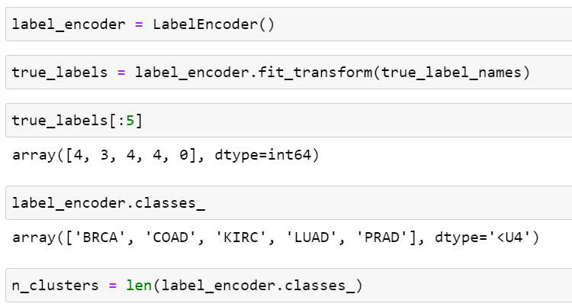
Encode
label_encoder = LabelEncoder()
true_labels = label_encoder.fit_transform(true_label_names)
true_labels[:5]
#透過labels將字串型別的label轉成int
label_encoder.classes_
# label_encoder儲存的原始label內容
n_clusters = len(label_encoder.classes_)

Slide 25
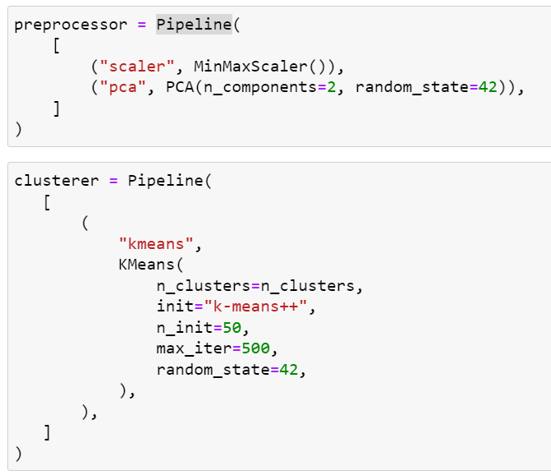
PipeLine
preprocessor = Pipeline(
[ ("scaler", MinMaxScaler()),
("pca", PCA(n_components=2, random_state=42)),
]
)
#使用pipeline封裝預處理器(歸一化+PCA降維)
clusterer = Pipeline(
[ ( "kmeans",
KMeans(
n_clusters=n_clusters,
init="k-means++",
n_init=50,
max_iter=500,
random_state=42,
),
),
]
) #使用pipeline封裝預clusterer(K-means)

Slide 26
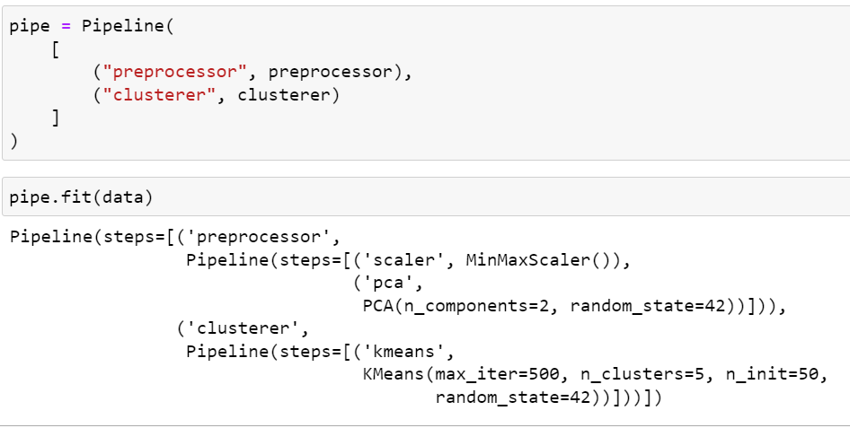
PipeLine
pipe = Pipeline(
[
("preprocessor", preprocessor),
("clusterer", clusterer)
]
) #使用pipeline封裝預處理器+ clusterer
pipe.fit(data)
#套入資料

Slide 27
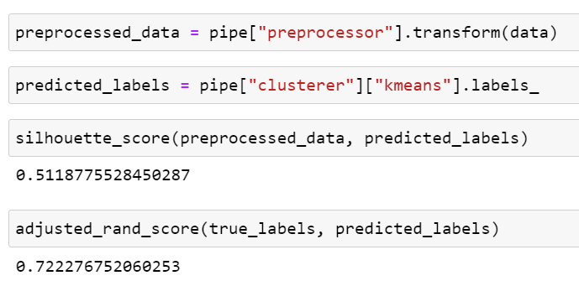
評估結果
preprocessed_data = pipe["preprocessor"].transform(data))
predicted_labels = pipe["clusterer"]["kmeans"].labels_
silhouette_score(preprocessed_data, predicted_labels)
#計算輪廓係數評估成效
adjusted_rand_score(true_labels, predicted_labels)
#計算ARI評估成效

Slide 28
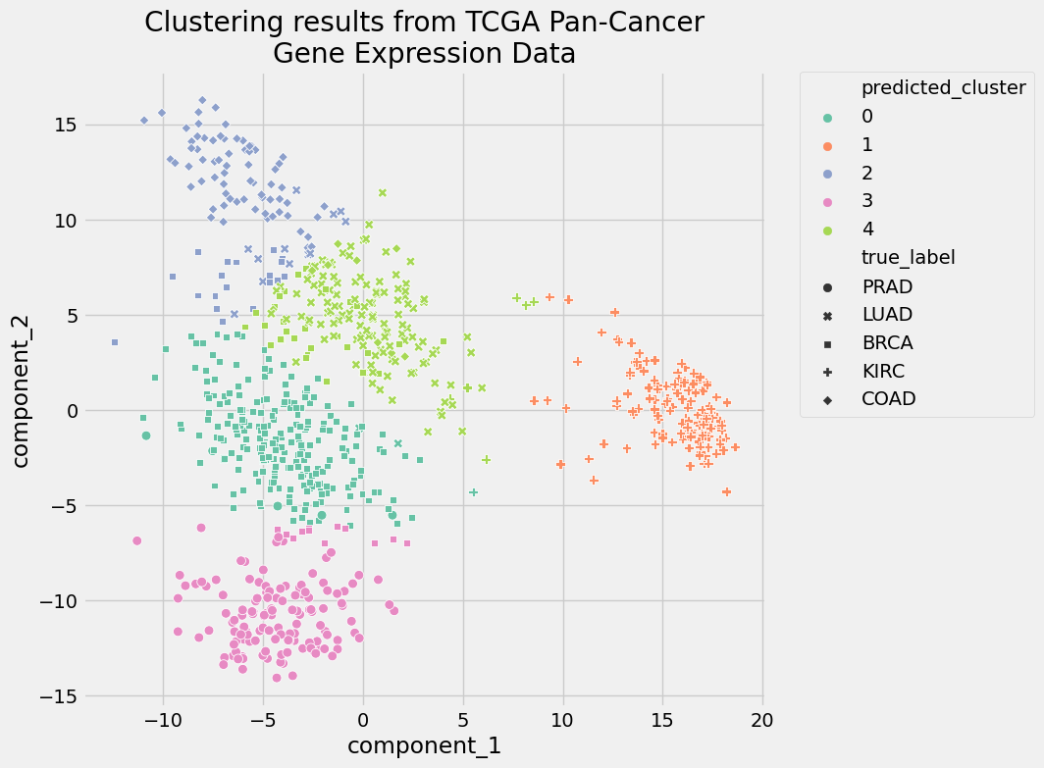
繪圖
pcadf = pd.DataFrame(
pipe["preprocessor"].transform(data),
columns=["component_1", "component_2"],
)
pcadf["predicted_cluster"] = pipe["clusterer"]["kmeans"].labels_
pcadf["true_label"] = label_encoder.inverse_transform(true_labels)
plt.style.use("fivethirtyeight")
plt.figure(figsize=(8, 8))
scat = sns.scatterplot(
“component_1”, "component_2",
s=50, data=pcadf, hue="predicted_cluster",
style=“true_label”, palette="Set2",
)
scat.set_title(
"Clustering results from TCGA Pan-Cancer\nGene Expression Data"
)
plt.legend(bbox_to_anchor=(1.05, 1), loc=2, borderaxespad=0.0)
plt.show()

Slide 29
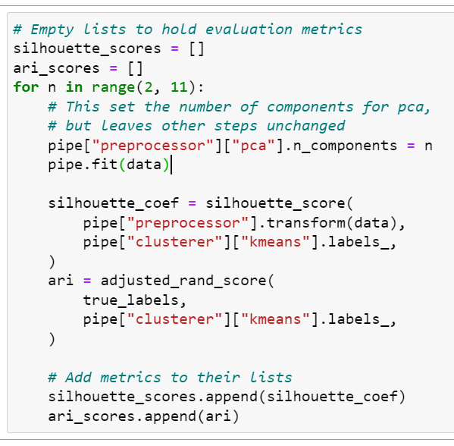
評估結果
silhouette_scores = []
ari_scores = []
for n in range(2, 11):
pipe["preprocessor"]["pca"].n_components = n
pipe.fit(data)
silhouette_coef = silhouette_score(
pipe["preprocessor"].transform(data),
pipe["clusterer"]["kmeans"].labels_,
)
ari = adjusted_rand_score(
true_labels,
pipe["clusterer"]["kmeans"].labels_,
)
silhouette_scores.append(silhouette_coef)
ari_scores.append(ari)
#產生降維成2~10個維度時的輪廓係數、ARI list

Slide 30
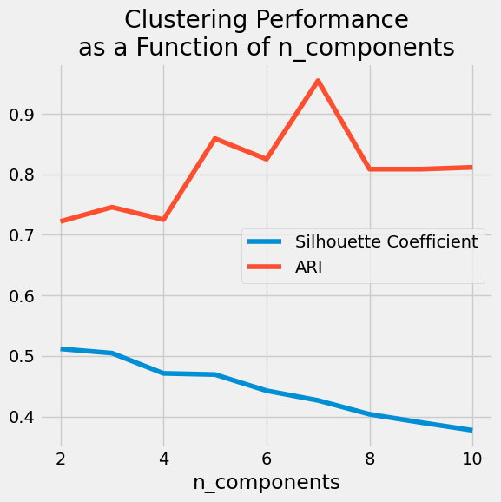
繪圖
plt.style.use("fivethirtyeight")
plt.figure(figsize=(6, 6))
plt.plot(
range(2, 11),
silhouette_scores,
c="#008fd5",
label="Silhouette Coefficient",
)
plt.plot(range(2, 11), ari_scores, c="#fc4f30", label="ARI")
plt.xlabel("n_components")
plt.legend()
plt.title("Clustering Performance\nas a Function of n_components")
plt.tight_layout()
plt.show()

